Slide 1

INTELLIGENT SYSTEMS
UNIT-II

Slide 2
Data
It can be any unprocessed fact, value, text, sound, or picture that is not being interpreted and analyzed. Data is the most important part of all Data Analytics, Machine Learning, Artificial Intelligence. Without data, we can’t train any model and all modern research and automation will go in vain. Big Enterprises are spending lots of money just to gather as much certain data as possible.
Example: Why did Facebook acquire WhatsApp by paying a huge price of $19 billion? The answer is very simple and logical – it is to have access to the users’ information that Facebook may not have but WhatsApp will have. This information of their users is of paramount importance to Facebook as it will facilitate the task of improvement in their services.

Slide 3
Properties of data
Volume: Scale of Data. With the growing world population and technology at exposure, huge data is being generated each and every millisecond.
Variety: Different forms of data – healthcare, images, videos, audio clippings.
Velocity: Rate of data streaming and generation.
Value: Meaningfulness of data in terms of information that researchers can infer from it.
Veracity: Certainty and correctness in data we are working on.

Slide 4
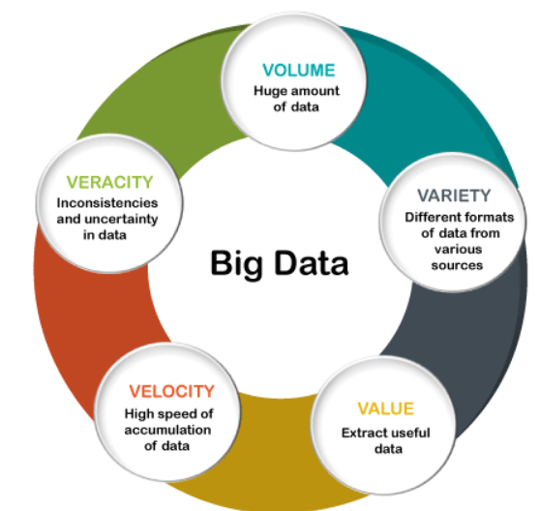

Slide 5
BIG DATA
Big Data contains a large amount of data that is not being processed by traditional data storage or the processing unit. It is used by many multinational companies to process the data and business of many organizations. The data flow would exceed 150 exabytes per day before replication.
There are five v's of Big Data that explains the characteristics.

Slide 6
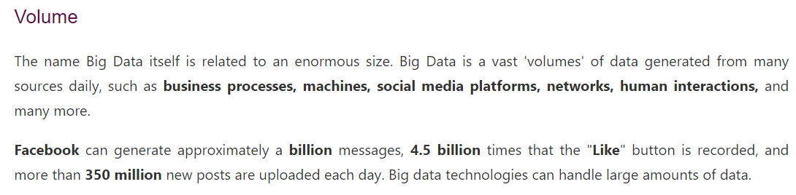

Slide 7
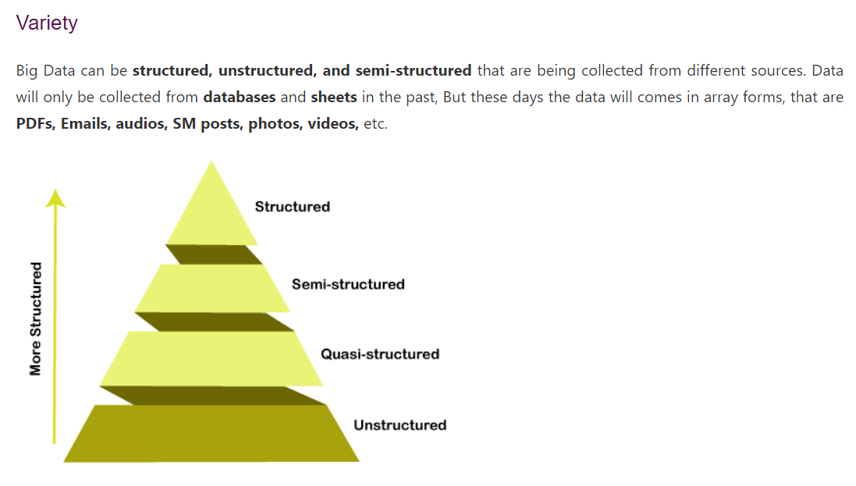

Slide 8
Variety
It refers to nature of data that is structured, semi-structured and unstructured data.
It also refers to heterogeneous sources.
Variety is basically the arrival of data from new sources that are both inside and outside of an enterprise. It can be structured, semi-structured and unstructured.
Structured data: This data is basically an organized data. It generally refers to data that has defined the length and format of data.
Semi- Structured data: This data is basically a semi-organised data. It is generally a form of data that do not conform to the formal structure of data. Log files are the examples of this type of data.
Unstructured data: This data basically refers to unorganized data. It generally refers to data that doesn’t fit neatly into the traditional row and column structure of the relational database. Texts, pictures, videos etc. are the examples of unstructured data which can’t be stored in the form of rows and columns.

Slide 9
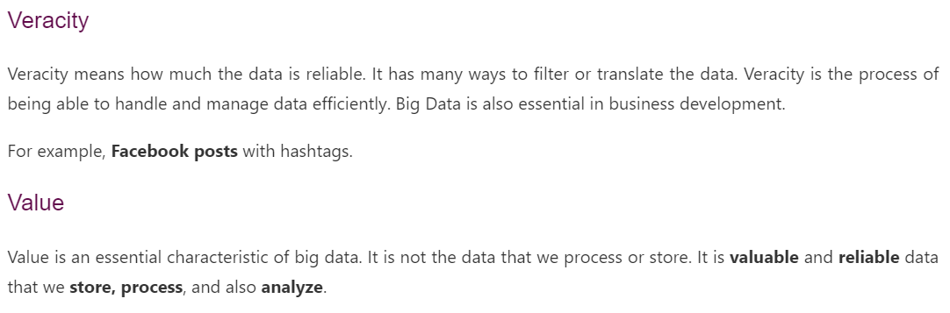

Slide 10
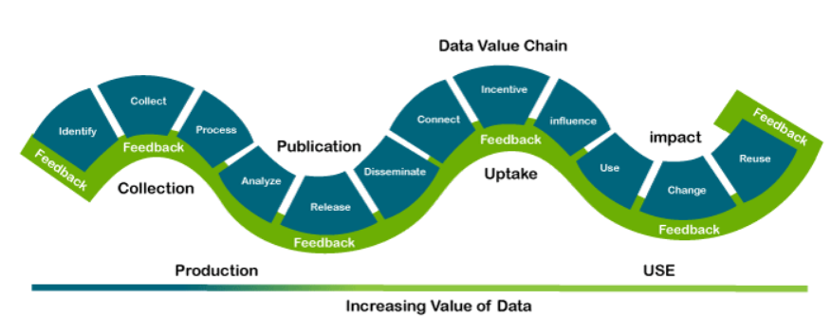

Slide 11
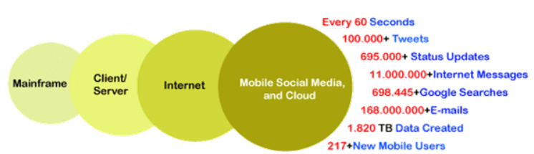
Velocity
Velocity plays an important role compared to others. Velocity creates the speed by which the data is created in real-time. It contains the linking of incoming data sets speeds, rate of change, and activity bursts. The primary aspect of Big Data is to provide demanding data rapidly.
Big data velocity deals with the speed at the data flows from sources like application logs, business processes, networks, and social media sites, sensors, mobile devices, etc.

Slide 12
Value
After having the 4 V’s into account there comes one more V which stands for Value! The bulk of Data having no Value is of no good to the company, unless you turn it into something useful.
Data in itself is of no use or importance but it needs to be converted into something valuable to extract Information. Hence, you can state that Value! is the most important V
You need data Analytics tools or software to analyze billions of data

Slide 13

Information and Knowledge
INFORMATION: Data that has been interpreted and manipulated and has now some meaningful inference for the users.
KNOWLEDGE: Combination of inferred information, experiences, learning, and insights. Results in awareness or concept building for an individual or organization.
In AI, one of the things that should be taken care of is the type of data given to the model. If we have more data, there is a higher chance for a machine learning algorithm to understand it and give accurate predictions to the unseen data respectively.

Slide 14
Types of data
Categorical Data
Numerical Data
Time Series Data
Text Data

Slide 15
Categorical data
In this type of data, we have different categories representing particular object respectively. Consider, for instance, the color of the car. There can be many colors such as green, blue or silver. Since the data is not numerical and consists of different categories of the color of the car, we call it a categorical data respectively.
Below, we see that there are three categories of colors. We would be performing one hot encoding so that the categorical data is converted to numerical data for computation. We have to always remember that a machine learning algorithm would only take mathematical values as input and thus, perform computations. Hence, the entire data must be converted into some forms of numbers for computation respectively.

Slide 16
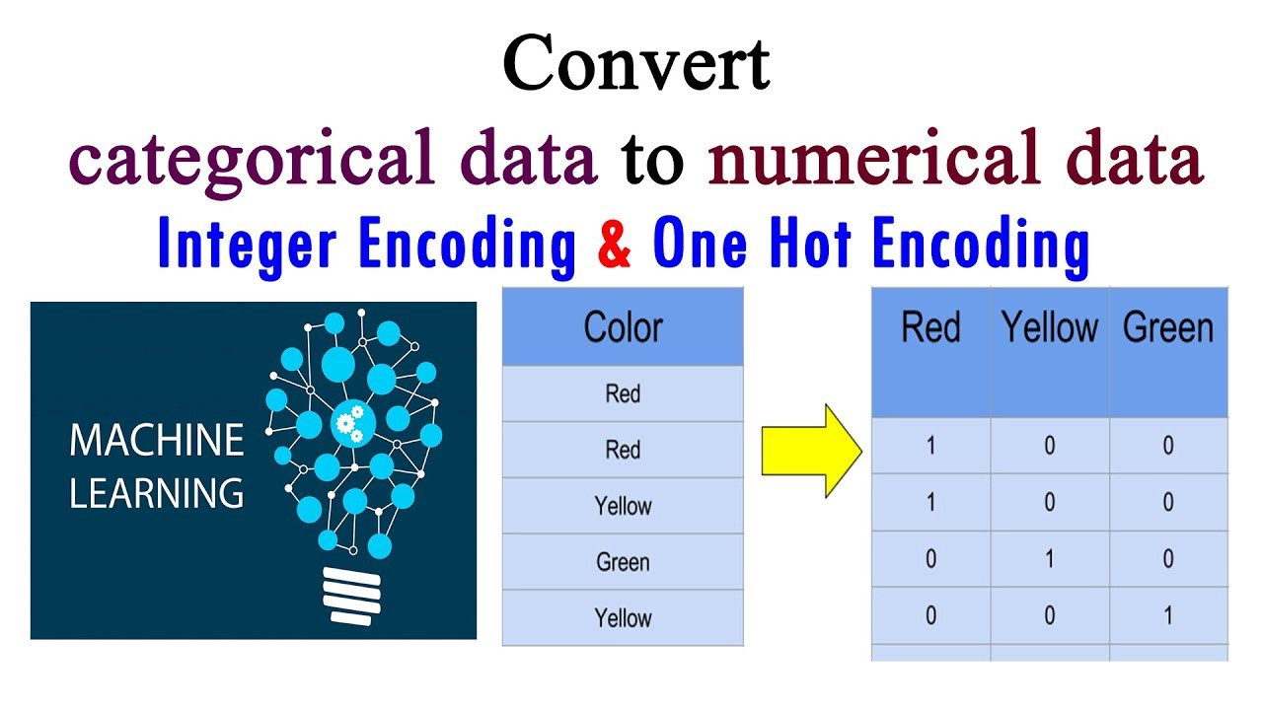
Categorical data

Slide 17
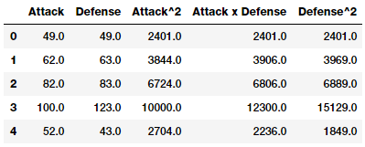
Numerical data
As the name implies, we would be working with just numbers in the case of numerical data. Below, we see that there are different set of features such as attack, defense and so on. In addition, we see that there are specific set of numerical values associated with them respectively. We see that they are floating point numbers but we still see that they are numerical in nature. Therefore, we might come across a data set that might contain numerical data features along with categorical features respectively.

Slide 18
Time series data
Sometimes, it is also required to use the time series information and the data associated with it to improve the performance of a machine learnig model. Therefore, we would take into consideration the features that contain the time series information respectively. In a time series data, we would take the values of certain output values for a specific set of time interval and link those results with our data.
Therefore, we would be performing the machine learning operations with the time series information present in our data respectively. In the below image, we see a time series representation of a particular value in the data and the time interval between Jan 2019 to Jan 2020. We can use this feature and add it to our original data which might improve the accuracy of the machine learning model respectively.
Time series data is data that is recorded over consistent intervals of time.
Ex: stock price, house price over time, weather records.

Slide 19
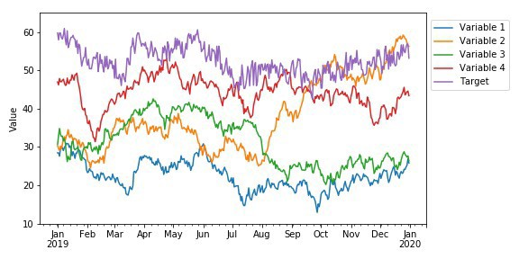
Time series data

Slide 20
Text data
There is a lot of text data available to us in the form of posts, articles and blogs. We would actually convert the text data into a mathematical vector by using different forms of vectorization so that we get mathematical forms of the text which could later be used by machine learning algorithms for prediction. We have different vectorizers in python such as BOW (Bag-of-words) vectorizer and TFIDF(Term frequency and inverse document frequency) vectorizer which convert the text at hand to their mathematical equivalent which, in turn, could be used by the machine learning models for predictions.

Slide 21
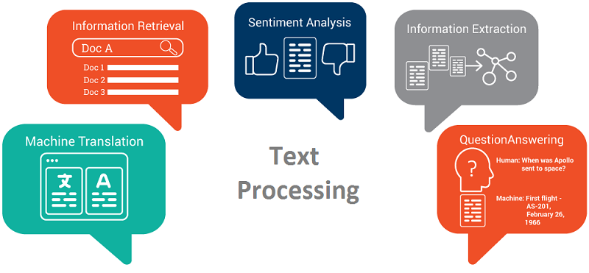
Text data

Slide 22
Why is machine learning important?
Machine learning is a form of artificial intelligence (AI) that teaches computers to think in a similar way to humans: learning and improving upon past experiences. Almost any task that can be completed with a data-defined pattern or set of rules can be automated with machine learning.
So, why is machine learning important? It allows companies to transform processes that were previously only possible for humans to perform—think responding to customer service calls, bookkeeping, and reviewing resumes for everyday businesses. Machine learning can also scale to handle larger problems and technical questions—think image detection for self-driving cars, predicting natural disaster locations and timelines, and understanding the potential interaction of drugs with medical conditions before clinical trials. That’s why machine learning is important.

Slide 23
Why is data important for machine learning?
We’ve covered the question ‘why is machine learning important,’ now we need to understand the role data plays. Machine learning data analysis uses algorithms to continuously improve itself over time, but quality data is necessary for these models to operate efficiently.
To truly understand how machine learning works, you must also understand the data by which it operates. Now, we will be discussing what machine learning datasets are, the types of data needed for machine learning to be effective, and where engineers can find datasets to use in their own machine learning models.

Slide 24
What is the value of data for machine learning ?
Data is crucial for machine learning, and without data, machine learning is not possible. It requires data in one form or the other.
Just like we humans need food for our development of mind and then when we get another type of data by visualizing, hearing, etc., and get experience from such data. That data plays a vital role in the type of human we will be in the future.
In the same way, data for machine learning is important to grow its experience and ability to make decisions based on the data fed to it.

Slide 25
What is a dataset in machine learning?
To understand what a dataset is, we must first discuss the components of a dataset.
A single row of data is called an instance.
Datasets are a collection of instances that all share a common attribute.
Machine learning models will generally contain a few different datasets, each used to fulfill various roles in the system.

Slide 26
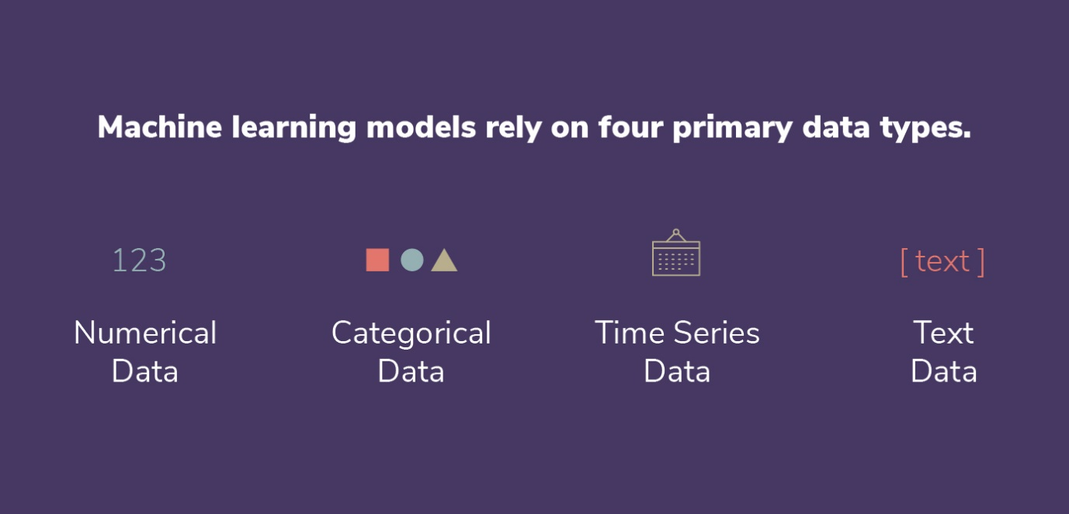
What type of data does machine learning need?
Data can come in many forms, but machine learning models rely on four primary data types. These include numerical data, categorical data, time series data, and text data.

Slide 27
Numerical data
Numerical data, or quantitative data, is any form of measurable data such as your height, weight, or the cost of your phone bill. You can determine if a set of data is numerical by attempting to average out the numbers or sort them in ascending or descending order. Exact or whole numbers (ie. 26 students in a class) are considered discrete numbers, while those which fall into a given range (ie. 3.6 percent interest rate) are considered continuous numbers. While learning this type of data, keep in mind that numerical data is not tied to any specific point in time, they are simply raw numbers.

Slide 28
Categorical data
Categorical data is sorted by defining characteristics. This can include gender, social class, ethnicity, hometown, the industry you work in, or a variety of other labels. While learning this data type, keep in mind that it is non-numerical, meaning you are unable to add them together, average them out, or sort them in any chronological order. Categorical data is great for grouping individuals or ideas that share similar attributes, helping your machine learning model streamline its data analysis.

Slide 29
Time series data
Time series data consists of data points that are indexed at specific points in time. More often than not, this data is collected at consistent intervals. Learning and utilizing time series data makes it easy to compare data from week to week, month to month, year to year, or according to any other time-based metric you desire. The distinct difference between time series data and numerical data is that time series data has established starting and ending points, while numerical data is simply a collection of numbers that aren’t rooted in particular time periods.

Slide 30
Text data
Text data is simply words, sentences, or paragraphs that can provide some level of insight to your machine learning models. Since these words can be difficult for models to interpret on their own, they are most often grouped together or analyzed using various methods such as word frequency, text classification, or sentiment analysis.

Slide 31
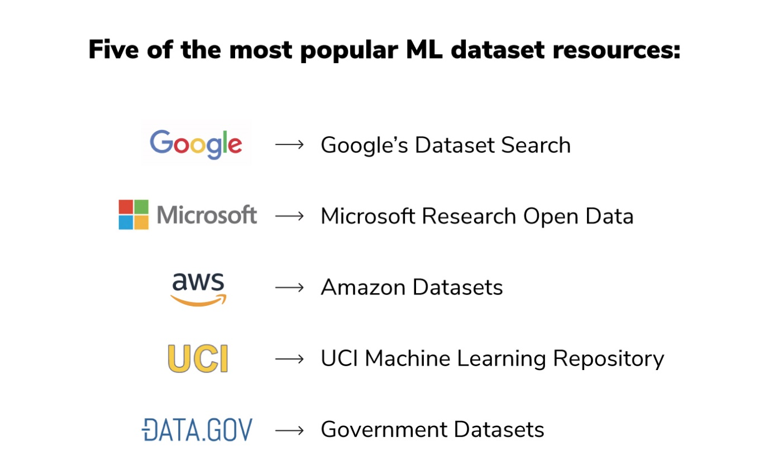
Where do engineers get datasets for machine learning?
There is an abundance of places you can find machine learning data, but we have compiled five of the most popular ML dataset resources to help get you started:

Slide 32
Why is machine learning popular?
Machine learning is a booming technology because it benefits every type of business across every industry. The applications are limitless. From healthcare to financial services, transportation to cyber security, and marketing to government, machine learning can help every type of business adapt and move forward in an agile manner.
You might be good at sifting through a massive organized spreadsheet and identifying a pattern, but thanks to machine learning and artificial intelligence, algorithms can examine much larger datasets and understand connective patterns even faster than any human, or any human-created spreadsheet function, ever could. Machine learning allows businesses to collect insights quickly and efficiently, speeding the time to business value. That’s why machine learning is important for every organization.
Machine learning also takes the guesswork out of decisions. While you may be able to make assumptions based on data averages from spreadsheets or databases, machine learning algorithms can analyze massive volumes of data to provide exhaustive insights from a comprehensive picture. Put shortly: machine learning allows for higher accuracy outputs across an ever growing amount of inputs.

Slide 33
Why is machine learning popular?
For machine learning models to understand how to perform various actions, training datasets must first be fed into the machine learning algorithm, followed by validation datasets (or testing datasets) to ensure that the model is interpreting this data accurately.
Once you feed these training and validation sets into the system, subsequent datasets can then be used to sculpt your machine learning model going forward. The more data you provide to the ML system, the faster that model can learn and improve.

Slide 34
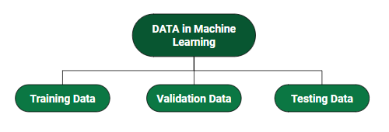
How do we split dataset in ML?

Slide 35
How do we split dataset in ML?
Training Data: The part of data we use to train our model. This is the data that your model actually sees and learns from.
Validation Data: The part of data that is used to do a frequent evaluation of the model, fit on the training dataset along with improving involved hyperparameters (initially set parameters before the model begins learning). This data plays its part when the model is actually training.
Testing Data: Once our model is completely trained, testing data provides an unbiased evaluation. When we feed in the inputs of Testing data, our model will predict some values(without seeing actual output). After prediction, we evaluate our model by comparing it with the actual output present in the testing data. This is how we evaluate and see how much our model has learned from the experiences feed in as training data, set at the time of training.

